Slide 1
Intro to Phylosophy
Notes:
Here are suggested teacher notes for the slide: Notes: - Name some early philosophers like Confucius, Laozi, Socrates, Plato, Aristotle to give students examples across traditions - Explain how early philosophers tried to understand the natural world, laying foundations for science - Emphasize that philosophy helps us make sense of the bigger questions in a reasoned way - Note that philosophy emerged in different ancient cultures like Greece, China, India Student Exercises: - Have students research an early philosopher and share a key idea of theirs - Ask students to discuss in pairs: How did early thinkers influence the development of science? - Invite students to give examples of big questions philosophy addresses - Ask students to name 2-3 cultures where philosophy originated and key philosophers from them

Slide 2

What is Philosophy? - Hard to define, itself a philosophical activity - Attempts to understand the world broadly and fundamentally - Nature, consciousness, morality, beauty, society - Considers range of subjects, no assumptions - Open-endedness makes it confusing
Notes:
Here are some suggested notes to help a teacher effectively communicate this slide to a class of 25-year-old students: Notes: - Philosophy examines the fundamental nature of knowledge, reality, and existence. It asks broad, open-ended questions about who we are and how we should live. - There is no agreed upon definition of philosophy. Questioning definitions and assumptions is part of doing philosophy. - Philosophy considers subjects like consciousness, society, morality, and beauty. It uses reason and logic rather than experiments. - For students: Have them discuss what big questions they think are important to understanding human life and society. Get them to challenge assumptions in their thinking. - Ask students to pick a philosophical question that interests them and freewrite on their thoughts, without judging if they are right or wrong. Then have volunteers share. - Optional activity: Divide students into small groups and assign each group a branch of philosophy (ethics, logic, epistemology etc). Have them research and then present the key questions of that area.

Slide 3
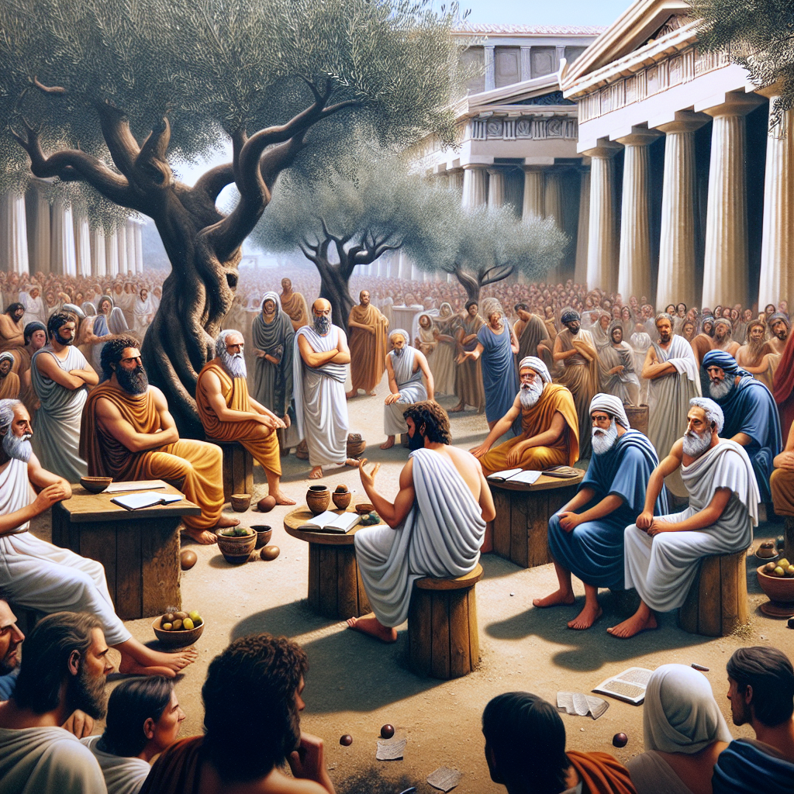
Historical Origins - "Lover of wisdom" - ancient Greek philosophers were called sages - Willingness to question traditions and apply reason - Curious about nature, human nature, society - Mostly patriarchal societies, few opportunities for women
Notes:
Here are suggested teacher notes for delivering the content on this slide: - Define philosophy as meaning "lover of wisdom" in Greek. Explain that ancient Greek thinkers focused on questioning traditions and applying reason to understand nature, human nature, and society. - Note that opportunities for women in philosophy were limited due to the patriarchal structure of ancient societies. - Ask students to name any female philosophers they know from ancient times. After a few responses, inform them of historical figures like Hipparchia the Cynic if they do not come up. - Have students break into small groups to discuss a question: If more women had opportunities in ancient philosophy, how might the field look different today? After a few minutes of discussion, have each group share their thoughts with the class.

Slide 4
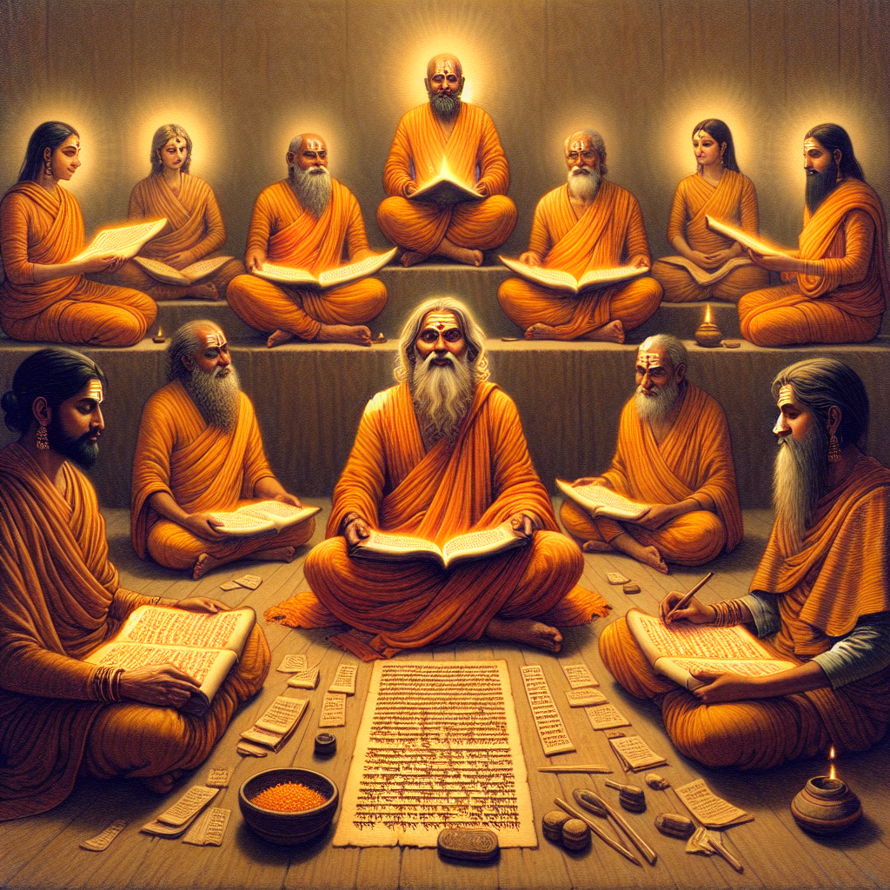
Indian Sages - Seven mythic sages authored the Vedas - Live monastic lives, meditate for wisdom - Some women made contributions - Ghosha - healed herself through spiritual practices - Maitreyi - composed Vedic hymns - Gargi - dialogues with Yajnavalkya
Notes:
Here are some suggested notes to help a teacher effectively communicate the content on the "Indian Sages" slide: Notes: - The Vedas, ancient Indian religious texts, are believed to have been authored by 7 mythical sages - These sages lived monastic, contemplative lives seeking spiritual wisdom and enlightenment through meditation - Some influential female thinkers also made important contributions to Vedic philosophy and spirituality - Ghosha - used spiritual practices to heal herself - Maitreyi - wrote Vedic hymns - Gargi - engaged in philosophical dialogues with sage Yajnavalkya Discussion Questions: - What do we know about the lives of the 7 mythical sages? What spiritual practices did they pursue? - How was Ghosha able to heal herself? What role did spirituality play? - What distinguishes Maitreyi's and Gargi's contributions to Vedic philosophy? Student Exercise: - Have students research one of the female sages named on the slide and share a short summary of her story and contributions

Slide 5
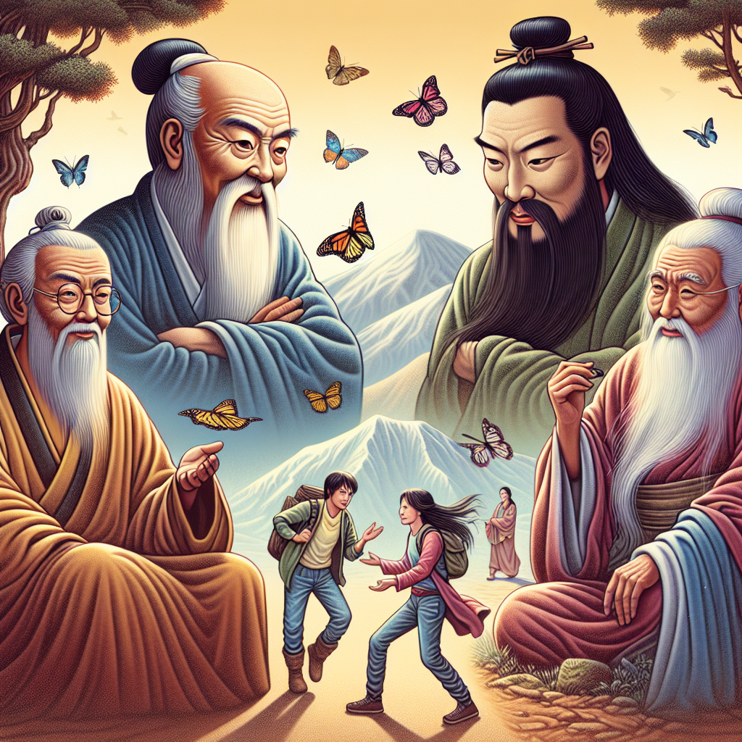
Chinese Sages - Kongzi (Confucius) - social harmony - Laozi - natural harmony - Zhuangzi - carefree wandering - Mozi - universal love - Some women philosophers but still very patriarchal
Notes:
Here are suggested teacher notes for delivering the content on this slide: Notes: - Introduce Kongzi (Confucius) and his philosophy of social harmony - focus on rituals, filial piety, humaneness. Good discussion question: How did he think social harmony should be achieved? - Explain Laozi's philosophy of natural harmony - focus on the Dao, wu-wei, simplicity. Discussion question: How did he differ from Confucius? - Discuss Zhuangzi's carefree wandering - skepticism, questioning conventional values. Question: Why did he criticize material success? - Briefly cover Mozi's philosophy of universal love. Question: How was his view different from Confucian love? - Note some women philosophers but male dominance. Ask students if they can name any women thinkers. Possible exercise: In groups, have students discuss which philosophy resonates most with them and why. Then share with the class. Let me know if you need any clarification or have additional suggestions for effectively covering this content! I aimed to summarize key points and pose engaging discussion questions.

